Slide 1


Yunus Emre Gündüz
November 18, 2022

Slide 2
Outline
Executive Summary
Introduction
Methodology
Results
Conclusion
Appendix

Slide 3
Executive Summary
The methodologies used to analyze data:
Data collection using web scraping from Wikipedia [1] and using SpaceX api [2]
Data wrangling including filling null spaces and merging several data resources
Exploratory data analysis (EDA) by
visualizing the relationships between different features of the data
SQL queries
Locating launch sites on the map using folium
Creating interactive dashboard to enable data to be inspected easily

Slide 4
Executive Summary
The following results are acquired:
Exploratory data analysis gives us insights about the rocket launches and relationship of different features in the dataset.
Interactive dashboard can be used to inspect the correlation between success rate and payload mass.
SpaceX's first stage landing can be predicted that if it will fail or succeed.
Predictions which made by different classification algorithms result in close accuracy rate which is about %85.

Slide 5
Introduction
A new commercial rocket launcher company
wants to bid against SpaceX
needs to advertise their rocket launches with a lower-cost
decided to analyze Falcon 9 launches to find a way
Problems looking for answers:
The best way to predict whether the first stage lands successfully or not, which directly impacts on the cost
The best place to execute rocket launches

Slide 6

Section 1

Slide 7
Methodology
Executive Summary
Data collection methodology:
web scrapping from Wikipedia's "List of Falcon 9 and Falcon Heavy Launches" page [1]
requesting data using SpaceX's API [2]
Perform data wrangling
The data is enriched by creating a landing outcome label
Orbits and launch sites are analyzed
Perform exploratory data analysis (EDA) using visualization and SQL

Slide 8
Methodology
Executive Summary
Perform interactive visual analytics using Folium and Plotly Dash
Perform predictive analysis using classification models
The data is standardized
Train-test split approach is used
The best hyperparameter for support vector machine (SVM), logistic regression, classification trees and k-nearest neighbors (KNN) is found
The best-performing method is obtained

Slide 9
Data Collection
SpaceX's API [2] is called by requesting data from five different websites, which are combined:
Wikipedia's "List of Falcon 9 and Heavy Launches" page is web scrapped
(https://en.wikipedia.org/w/index.php?title=List_of_Falcon_9_and_Falcon_Heavy_launches&oldid=1027686922)
Note: Because the page is updated, to maintain consistency in the assignment, a snapshot is used.
https://api.spacexdata.com/v4/
"(…)rockets/"+rocket_id
"(…)cores/"+core_id
"(…)launches/past"
"(…)payloads/"+payload
"(…)launchpads/"+launchpad_id
Data
Figure 1. Flowchart showing SpaceX REST call process

Slide 10
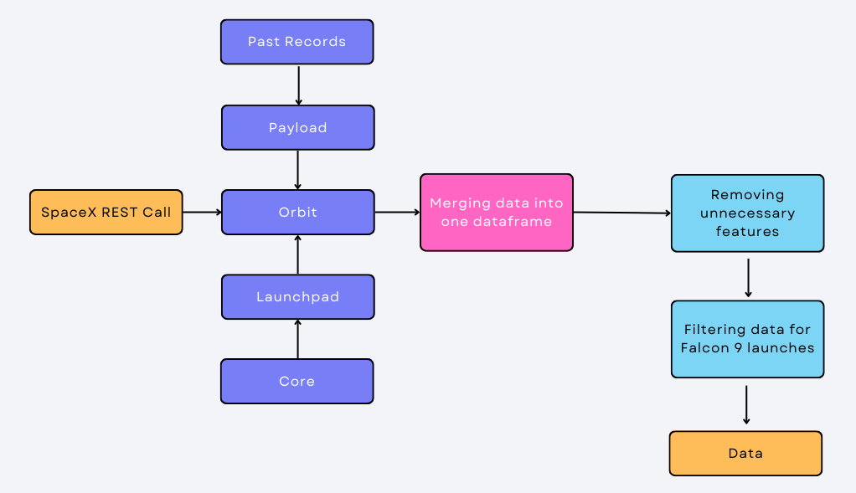
Data Collection – SpaceX API
The data contains 90 rows after filtering
Link for code
Figure 2. A detailed flowchart showing data collection from SpaceX APIprocess

Slide 11
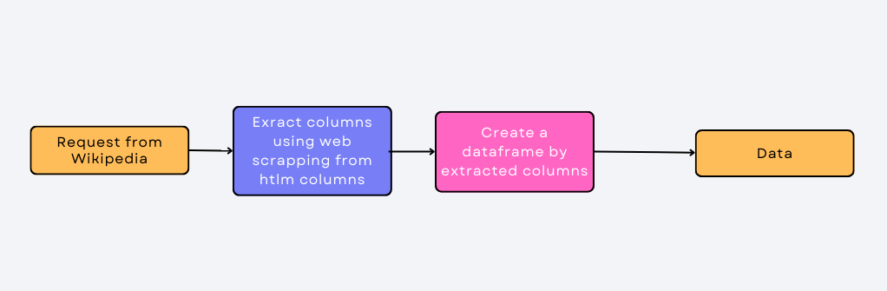
Data Collection - Scraping
The data contains 121 rows and 11 columns at the end
Figure 3. Flowchart showing web scrapping from Wikipedia
Link for code

Slide 12
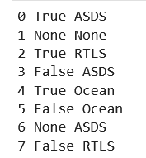
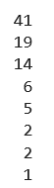
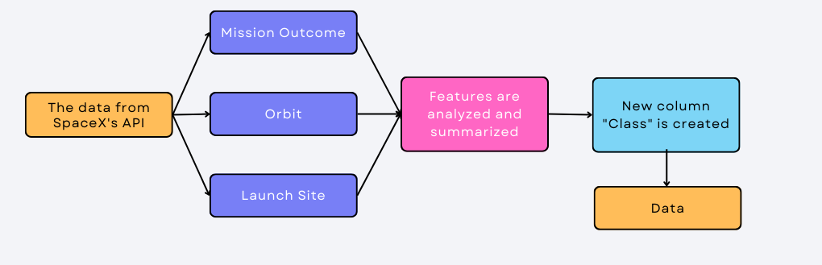
Data Wrangling
The data, collected by SpaceX API, is used
Orbits, launch sites, and mission outcomes are summarized
New feature, called «Class» is created based on mission outcomes as shown in figure 1
Class
1
0
Figure 5. Mission Outcomes and their counts
Link for code
Figure 4. Flowchart showing data wrangling process

Slide 13
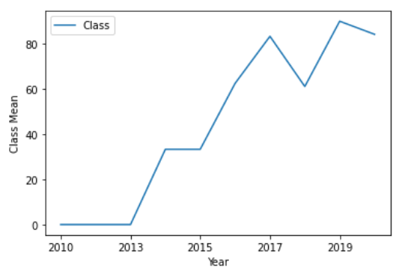
EDA with Data Visualization
Different types of graphs and charts are created to analyze the relationships between the data as written on the right
At the end, categorical columns are converted into dummy variables to enable prediction models to consider them
Scatter plots:
Payload mass vs. Flight number
Launch sites vs. Flight number
Payload mass vs Launch site
Orbit type vs Flight number
Payload mass vs Orbit type
Bar graph:
Success rate of different orbit types
Line graph:
Launch success rate yearly trend
Link for code
Figure 6. Success rate yearly trend

Slide 14
EDA with SQL
The data, fetched from Wikipedia’s page, is used
All launch sites for Falcon 9 are detected
5 records where launch sites begin with the string 'CCA’ are displayed
Total payload mass carried by boosters launched by NASA (CRS) is printed
Average payload mass carried by booster version F9 v1.1 is calculated
The date of first successful landing for ground pad is obtained
The names of the boosters which have success in drone ship and have payload mass greater than 4000 but less than 6000 are listed
Mission outcomes are summarized
The names of the booster versions which have carried the maximum payload mass are listed
The failed landing outcomes in drone ship, their booster versions, and launch site names for in year 2015 are extracted
Landing outcomes and the number of them within specified dates are shown
Link for code

Slide 15
Build an Interactive Map with Folium
Different launch sites are shown on the map with markers and circles
The number of launches are displayed by clustering them with marker clusters in each launch sites
The proximity of each launch site to the nearest coastline, highway, railway and city is calculated and shown with a polyline on the map
Launch sites and their distances from mentioned locations are displayed on the map in order to:
To identify if they keep some certain distances to specific locations
To have an understanding of characteristics of an rocket launch site
Link for code

Slide 16
Build a Dashboard with Plotly Dash
A pie chart is created
The success rate at each launch site is visualized
The launch sites are compared according to their successful first stage landings
A scatter plot is added
The number of successful and failing landings within a specified payload mass is plotted with their booster versions
Link for code

Slide 17
Predictive Analysis (Classification)
X contains standardized version of the data fetched from Wikipedia
Y contains the class information if first stage landed succesfully from the data collected by calling SpaceX API
4 different classification models are built with SVM, KNN, logistic regression and classification trees.
The best hyperparameters are found by grid searching
Different models’ accuracy on the test data are compared among each other to find the best model
Link for code

Slide 18
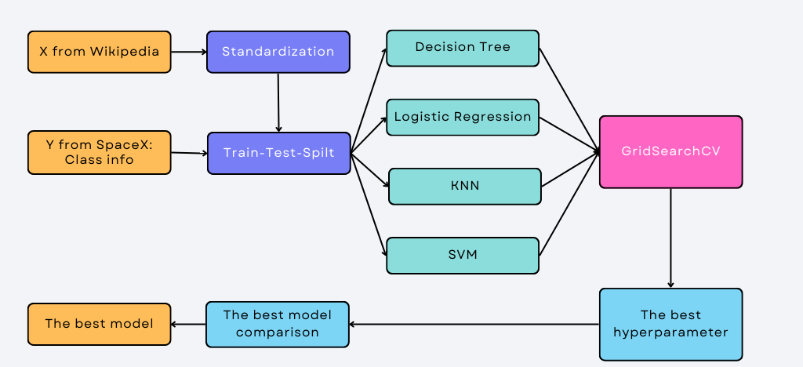
Predictive Analysis (Classification)
Link for code
Figure 7. Flowchart showing prediction proccess

Slide 19
Results
Exploratory data analysis results:
SpaceX uses 4 different launch sites
The average payload of F9 v1.1 is 2534 kg
The success rate rises over years
Payload mass has different impacts on the outcome for different ranges
Only 1 mission outcome is in failure
Orbits do not affect the launch outcome

Slide 20
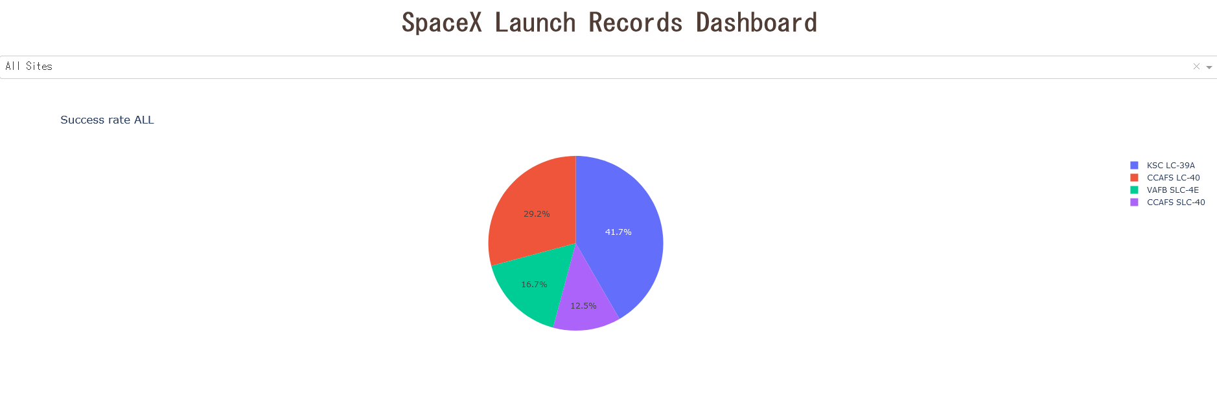
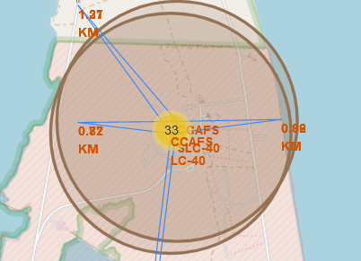
Results
Interactive analytics
An interactive dashboard is created
Characteristics of launch sites are detected
Figure 8. Success ratio for all launch sites
Figure 9. Distance from CCAFS SLC-40 to certain locations

Slide 21
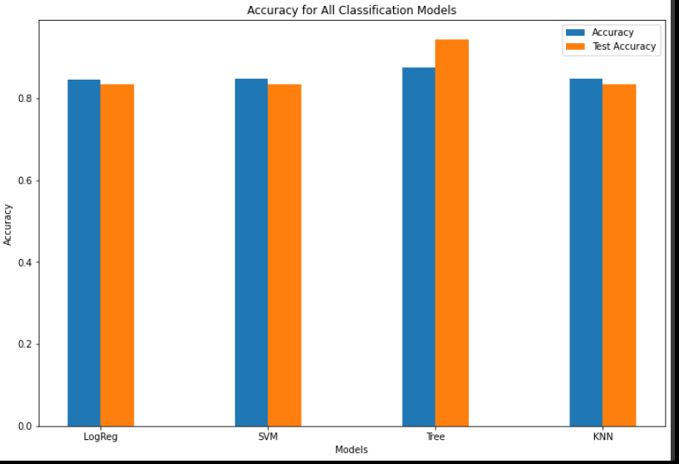
Results
Predictive Analysis
Decision Tree is found as the best model performing 94% accuracy on the test data
Figure 10. Accuracy of all models

Slide 22

Section 2

Slide 23
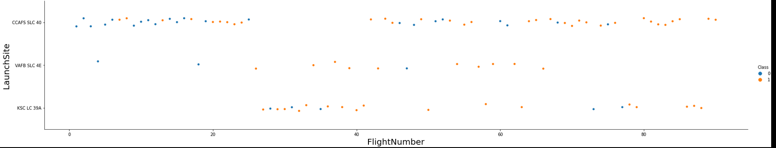
Flight Number vs. Launch Site
CCAFS SLC 40 has the success rate of %60, while VAFB SLC 4E and KSC LC 39A has the success rate of %77 in total
The general success rate rises over time
Launches from CCAFS SLC 40 had a considerable imporements compared to its first flights
Figure 11. Flight Number vs. Launch Site

Slide 24
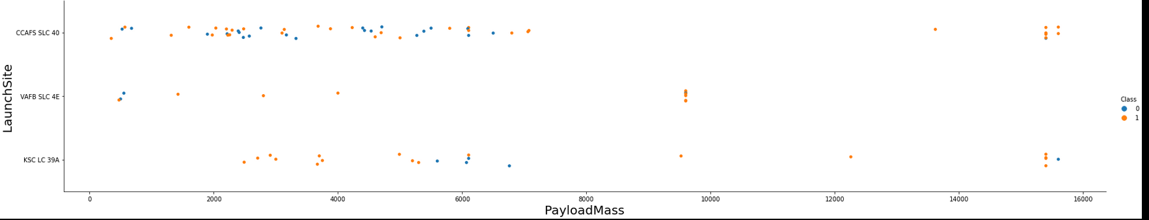
Payload vs. Launch Site
No launches more massive then 10000 kg is launched from VAFB SLC 4E
Common payload mass of rockets is gathered between 1000 and 8000
Launches having the payload mass between 8000 and 15000 is considerably rare
Launches massive then 7000 are less risky
Figure 11. Payload Mass vs. Launch Site

Slide 25
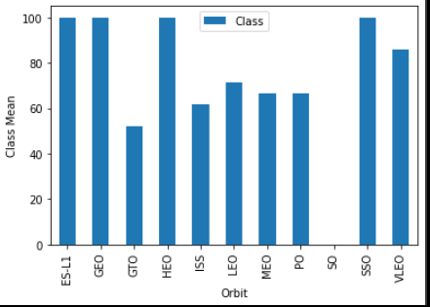
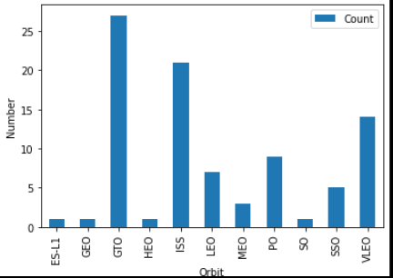
Success Rate vs. Orbit Type
The first stage of all rockets landed successfully, which are sent to ES-L1, GEO, HEO and SSO
However, when the number of launches to each orbit is visualized, it can be seen that the most successful orbits has the lowest number of launches.
The most commonly rocket-sent orbits have a success rate around 60%
Figure 12. Success Rate vs. Orbit Type
Figure 13. Orbit Type vs. Their Counts

Slide 26
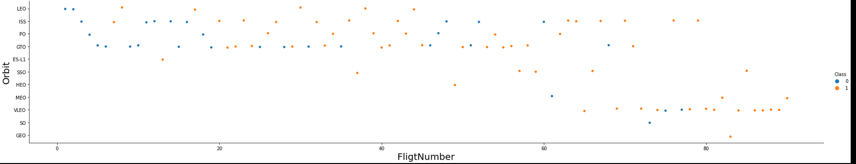
Flight Number vs. Orbit Type
VLEO, SO, GEO, MEO, HEO, SSO and ES-L1 orbits do not have any records in the early times of SpaceX Falcon9 launches
VLEO is the one where launches are preferred to be sent lately
The most of the Falcon 9 launches were sent o GTO, PO, ISS and LEO
Figure 14. Flight Number vs. Orbit Type

Slide 27
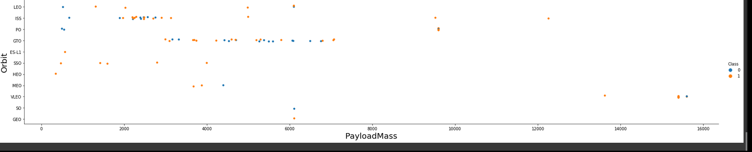
Payload vs. Orbit Type
VLEO receives the most massive launches
GTO, the most used orbit, receives launches between 3000 and 9000
There is no relation between the success rate and payload for GTO orbit
ISS has the largest payload range among other orbits
Figure 15. Payload Mass vs. Orbit Type

Slide 28
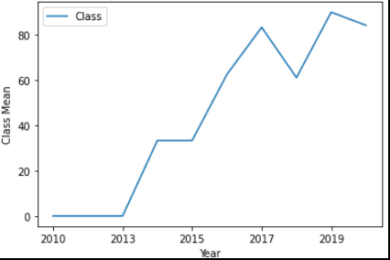
Launch Success Yearly Trend
Apparently, the first stage landing success rises over the years
The first years of first stage landing tries encountered with failure
Figure 6. Launch Success Yearly Trend

Slide 29
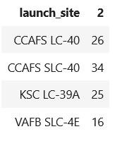
All Launch Site Names
CCAFS LC-40 and CCAFS SLC-40 indicates the same location, known with it a formal name as Cape Canaveral Air Force Station Space Launch Complex 40
The most commonly used launch site is Cape Canaveral Space Launch Complex 40, that has 60 launches in total for Falcon 9 heavy launches
KSC LC-39A come after CCAFS SLC-40 in the number of launches, followed by VAFB SLC-4E

Slide 30
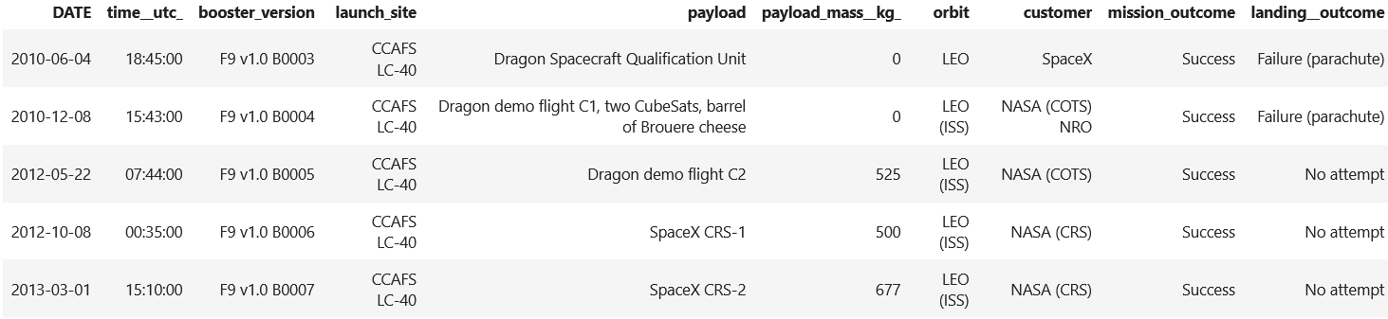
Launch Site Names Begin with 'CCA'
Here we can see 5 samples of Cape Canaveral Air Force Station launches

Slide 31
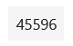
Total Payload Mass
The total payload carried by boosters from NASA is calculated as below:

Slide 32
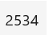
Average Payload Mass by F9 v1.1
The average payload mass carried by booster version F9 v1.1 is calculated as below:

Slide 33
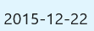
First Successful Ground Landing Date
The date of the first successful landing outcome on ground pad is found as below:

Slide 34
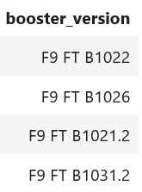
Successful Drone Ship Landing with Payload between 4000 and 6000
The names of boosters which have successfully landed on drone ship and had payload mass greater than 4000 but less than 6000:

Slide 35
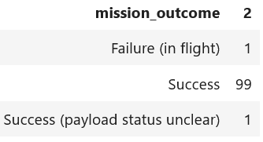
Total Number of Successful and Failure Mission Outcomes
The total number of successful and failure mission outcomes is calculated:

Slide 36

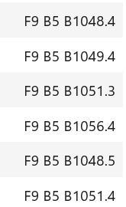
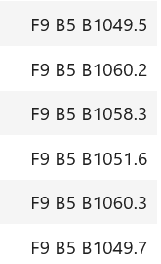
Boosters Carried Maximum Payload
The names of the booster which have carried the maximum payload mass:

Slide 37
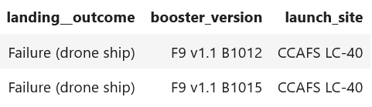
2015 Launch Records
The failed landing_outcomes in drone ship, their booster versions, and launch site names for in year 2015:

Slide 38
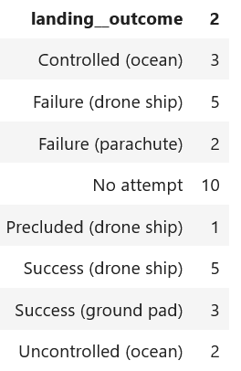
Rank Landing Outcomes Between 2010-06-04 and 2017-03-20
The count of landing outcomes (such as Failure (drone ship) or Success (ground pad)) between the date 2010-06-04 and 2017-03-20 is ranked in descending order:

Slide 39

Section 3

Slide 40
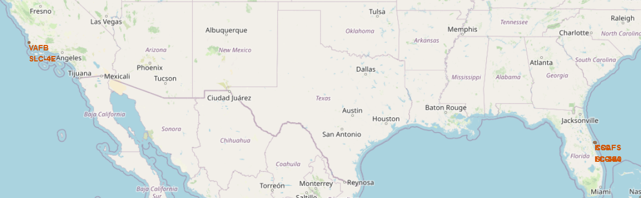
Location of All Launch Sites on the Map
VAFB SLC-4E, CCASF (S)LC-40, and KSC LC-39A are displayed on the map
While KSC LC-39A and CCASF (S)LC-40 are in close proximity to each other, VAFB SLC-4E is located on the other side of the country
Figure 16. Map of launch sites

Slide 41
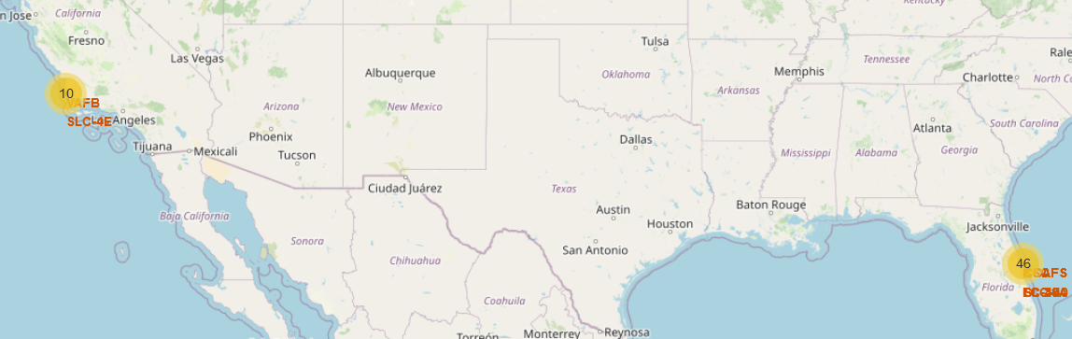
The Number of Launches on Each Launch Site
The most of the launches are made in the East side of the USA, namely 46.
CCAFS SLC-40 has the hightest number of launches, which is 33
KSC LC-39A and VAFB SLC-4E have 13 and 10 launches respectively
Figure 17. Map of clustered launches in different launch sites

Slide 42
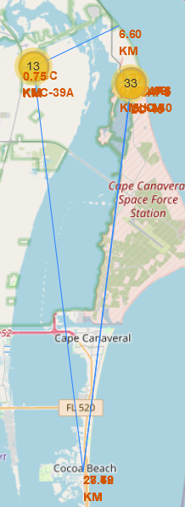
Distances between Launch Sites and Certain Locations
All of launch sites are in nearly 1KM proximity to coastline and railways
All of launch sites except VAFB SLC-4E are in nearly 1KM proximity to highways
All them keep at least 15KM distance from cities
Figure 9. Distance from CCAFS SLC-40 to certain locations
Figure 18. Distance from launch sites to certain locations

Slide 43

Section 4

Slide 44
Success Ratio for All Launch Sites
KSC LC-39A has the highest success ratio among others, followed by CCAFS SLC-40
Figure 19. Success ratio for all launch sites

Slide 45
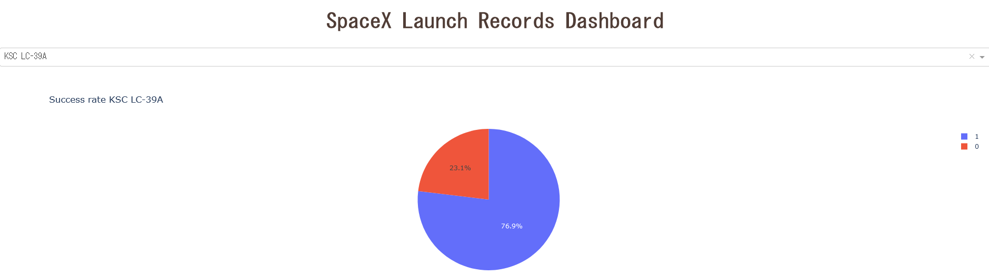
The Launch Site with Highest Launch Success Ratio
KSC LC-39A has 76.9% success ratio
Figure 20. The launch site with the highest launch success ratio

Slide 46
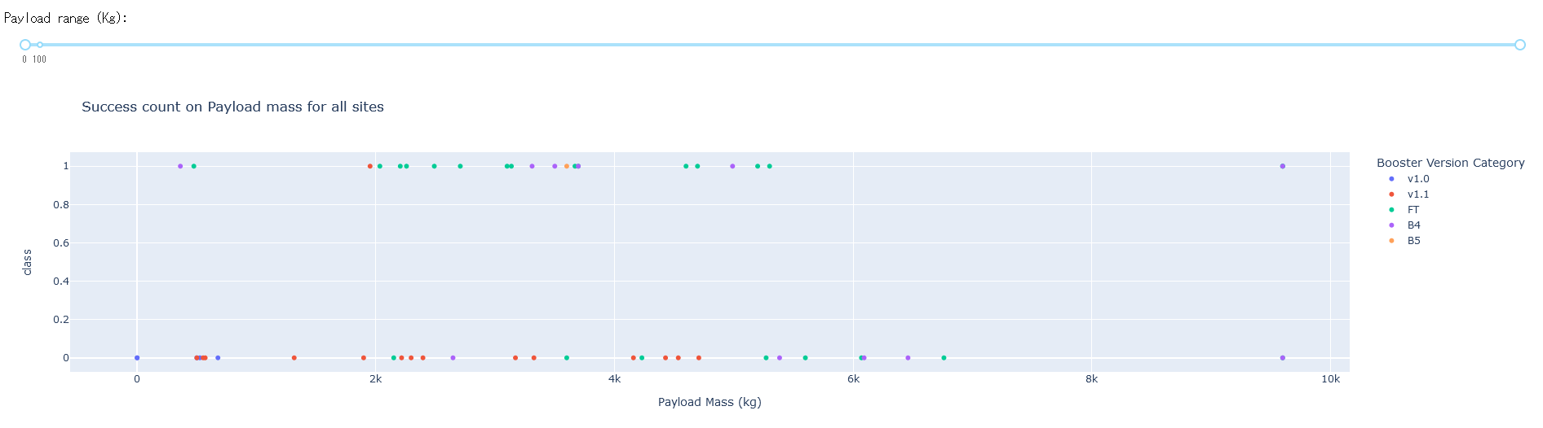
Success Count on Payload Mass for All Sites
Payload mass vs. launch outcome (Class) is visualized on a scatter plot, with booster version category and selectable payload range option
Figure 21. Success count on payload mass for all sites

Slide 47
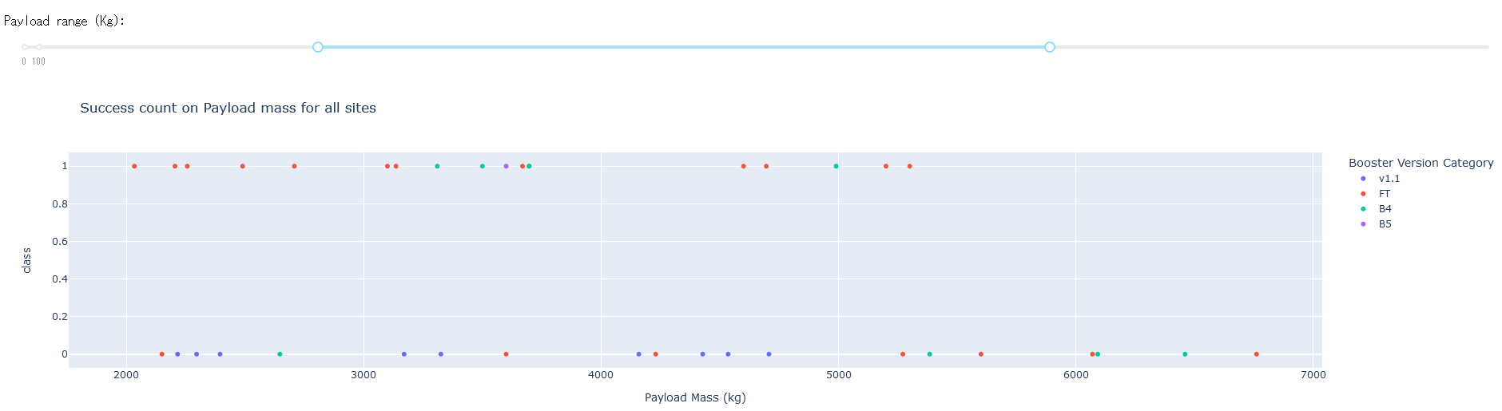
Success Count on Payload Mass for All Sites
Within the most commonly used payload range (2000-7000), it seems that successful launches are distributed equally among failing launches
Within this range FT booster version is the mostly used one
Figure 22. Success count on payload mass for all sites within a specified payload range

Slide 48

Section 5

Slide 49
Classification Accuracy
The best hyperparameter for each model is found by using GridSearchCV
The accuracies on the training data is the same for all models, namely 83%
Decision Tree model is the best-performing one on the test data, reaching 94% accuracy
Figure 10. Accuracy of all models

Slide 50
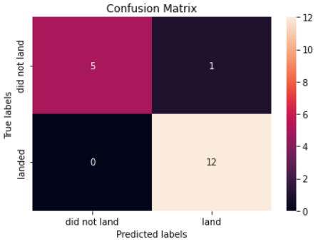
Confusion Matrix
On the test data which contains 18 rows, the built model predicted all of first stage landing results correctly except 1
Figure 23. Confusion matrix of decision tree model

Slide 51
Conclusions
The data is collected from different sourced, merged, and filtered for Falcon 9
The data is visualized and queried by SQL to make an exploratory data analysis
Launch sites are located on the map to inspect launch site characteristics
An interactive dashboard is built to have an understanding on the relationship between launch site, payload, and success rate
Different models are built to find the best performing-one, which is the classification tree model

Slide 52
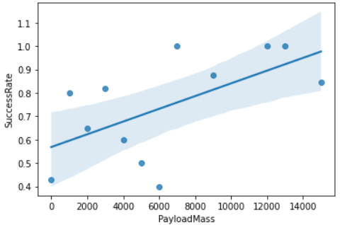
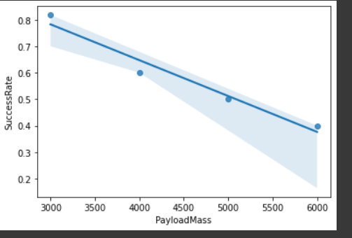
Appendix
Folium do not show maps on Github in files having ipynb extension. The maps are only available through this report presentation file
Whereas overall success rate increases as payload mass increase, it have a falling period between 3000 and 6000 payload mass in kg. Charts presented below.
Figure 24. Success Rate vs. Payload Mass regression plot
Figure 24. Success Rate vs. Payload Mass regression plot, payload between 3000 and 6000

Slide 53
Resources
[1] https://en.wikipedia.org/wiki/List_of_Falcon\_9\_and_Falcon_Heavy_launches
[2] https://api.spacexdata.com/v4/launches

Slide 54


